Slide 1
Jibebe Internship 2022
Progress report
Electric team
Name: ELIAS CHERUIYOT

Slide 2
Tasks completed last week
[#14] Electrical system experiment – The motor was appropriately connected to the controller which was in turn connected to a 53.7v rectifier which powered the system in place of the lithium battery that we are yet to acquire. This was necessary to determine the behaviour of the motor at start up. In place of the throttle switch that we are yet to receive we use a potentiometer to vary the voltage supplied to the bldc controller
[#13] Determination of required electric components – Brainstorming was done by the team and we were able to contact a number of suppliers of the items needed that includes Throttle switch and lithium battery
[#5]BLDC Motor Acquiring- We decided to go with the already available 1200W motor.

Slide 3
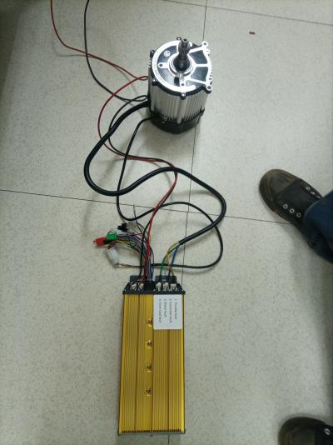
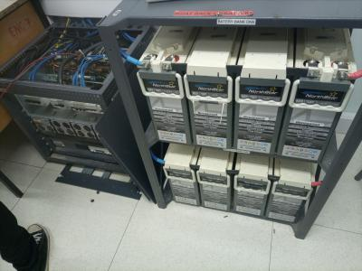
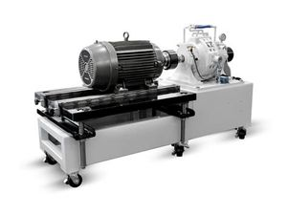

Slide 4
Tasks in this week
● [#4] Charge controller acquiring
● [#18]Analysis of performance curves
● [#30] Getting experimental characteristics of loading motor
● [#34] Determination of components for tractor and calculation of their values

Slide 5
Timeline
Month | Intern Week | Tasks
Jan | Week 1 | Design of required Battery Pack for Motor and Speed Control
 | Week 2 | Acquisition and procurement if required components
 | Week 3 | Testing of components fir tricycle and design of tractor electric system
Feb | Week 4 | Integration of ordered parts to final tricycle implementation. Procurement of components for tractor
 | Week 5 | Solving miscellaneous issues arising from tricycle. Testing of tractor components
 | Week 6 | Testing of tractor components
 | Week 7 | Integration of final electric system of tractor
 | Week 8 | Integration with other subsystems

